Slide 1
MissionGreenFuels
October 2024

Slide 2
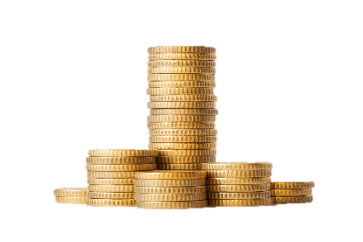
The four InnoMissions
Innomission 1
Capture and storage
or use of CO2
Research reserve 2023
301,8 mio. dkk
Research Reserve 2021
700 mio. dkk
Research reserve 2023
301,8 mio. dkk
700 mio. dkk
Innomission 2
Green fuels for transport and industry
(Power-to-X, etc.)
Innomission 3
Climate- and environment-friendly
agriculture and food production
Innomission 4
Circular economy with a focus on
plastics and textiles

Slide 3
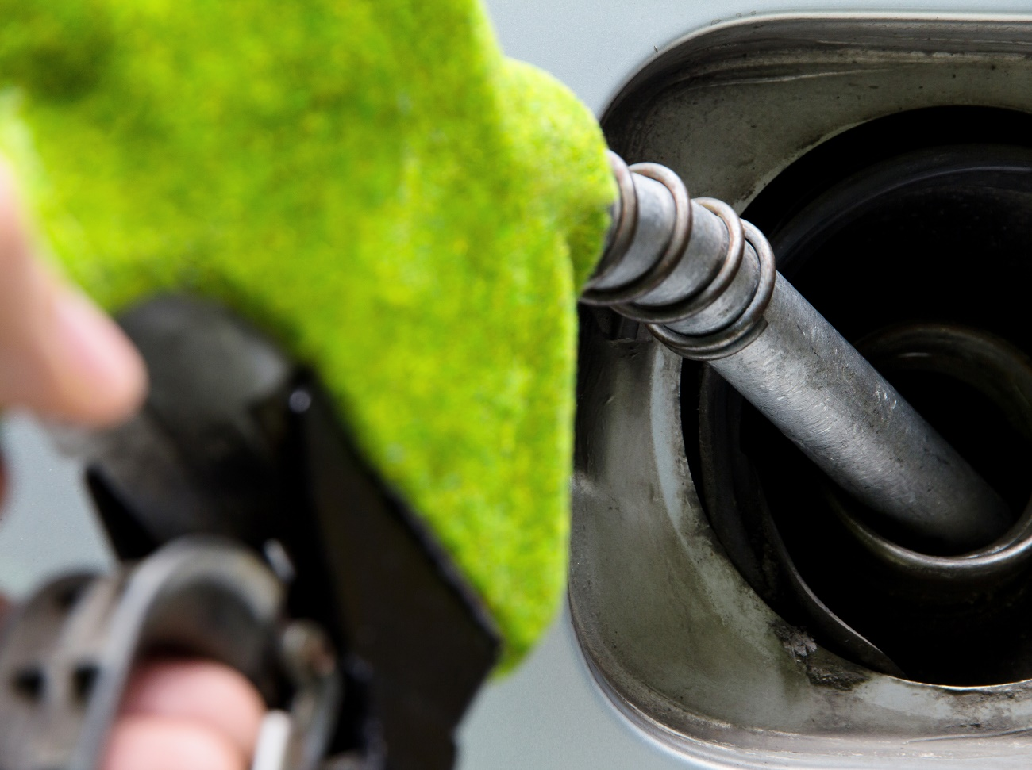
The MissionGreenFuels vision
To contribute substantially to the Danish, European and global climate goals, specifically by:
70 % reduction by 2030
net zero by 2045
and to support Danish research, innovation, growth, jobs and export potential within the field of green fuels

Slide 4
MissionGreenFuels’ Roadmap
Roadmap strengths:
Well-established and ambitious
Robust technical foundation
Involvement from the entire value chain
Roadmap update:
General update
More operational
Broader accessibility in the green transition.
Updated roadmap to be published late 2024.

Slide 5
(Inno)Mission approach
Danish Strengths
High international standing and many industry strongholds within green technologies.
Interplay between research and industry.
Identified need
Broader strategic plan based on broad coordination and commitment across the entire value chain to create the largest possible impact.
Approach
DK government launched mission-driven research efforts to make Denmark a frontrunner within the development of new green break-through technologies and contributing to a reduction of emissions in Denmark and globally.
The role of the roadmap
Crucial for ensuring that Denmark's efforts in green technology research and industry are strategically aligned and coordinated.

Slide 6
Status
2022
Now
?
Partners
56
≈100
Budget
≈ DKK 200 mio.
≈ DKK 350 mio.
+ Research Reserve 2024
+ Research Reserve 2025
Projects
9
21
21 + ?

Slide 7
Pool 1
Pool 2
Pool 1
Pool 3
2023 300 mio. dkk research reserve.
August 2024 Calls published.
Pool 4
2024 320 mio. dkk research reserve.
2024 IFD will announce a call for research reserve in competition among the 4 innomission.
Pool 1
Pool 2
9 Projects
174 mio. dkk
total budget
12 Projects
79,5 mio. dkk
total budget
97
mio. dkk IFD Investment
67 mio. dkk
co-financing
56,5
mio. dkk IFD Investment
24 mio. dkk
co-financing
ComElCo
H2-SAF
COMPAS
MTHiO
DYNFLEX
R2P2X
GREMEOH
STAB3
HyFueling HD
SAFE
COMON
CARMA-GreenFuels
Methanol-to-Jet
SafeSBU
PtX Sector Coupling and LCA
PtX Markets
Safer and faster PtX
Safer and faster PtX
DEEP
PtX Infrastructure
PowerLBG
RIGHydro
Budgets from 2.5 to 51 million dkk.
Budgets from 2.7 to 12.2 million dkk.

Slide 8
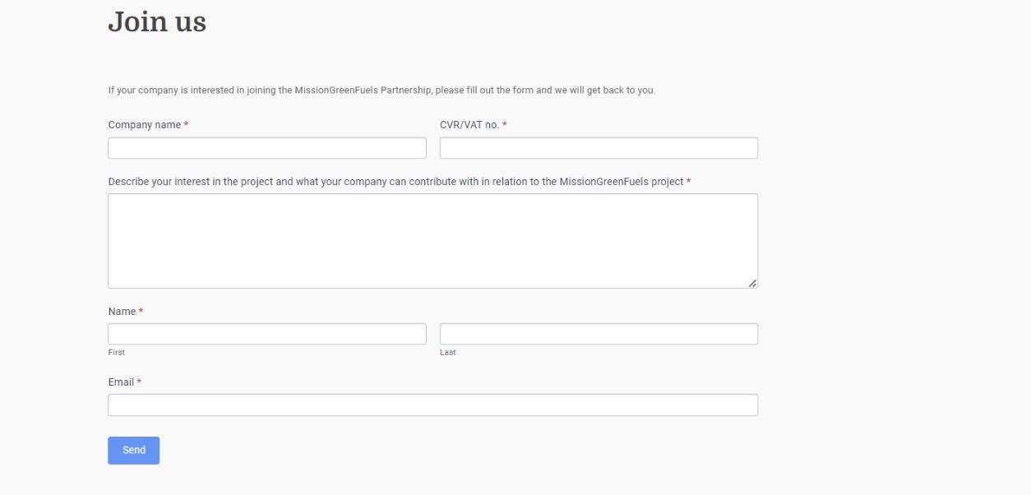
Join our Mission
Apply for partnership on our website:
www.missiongreenfuels.dk

Slide 10
Thank you for the attention
This project has received funding from The Innovation Fund Denmark – 1150-00001B.

